Slide 1
Functional Programming

Slide 2
From the Official Python Documentation
Programming languages support decomposing problems in several different ways:
Most programming languages are procedural: programs are lists of instructions that tell the computer what to do with the program’s input. C, Pascal, and even Unix shells are procedural languages.
In declarative languages, you write a specification that describes the problem to be solved, and the language implementation figures out how to perform the computation efficiently. SQL is the declarative language you’re most likely to be familiar with; a SQL query describes the data set you want to retrieve, and the SQL engine decides whether to scan tables or use indexes, which subclauses should be performed first, etc.
Object-oriented programs manipulate collections of objects. Objects have internal state and support methods that query or modify this internal state in some way. Smalltalk and Java are object-oriented languages. C++ and Python are languages that support object-oriented programming, but don’t force the use of object-oriented features.
Functional programming decomposes a problem into a set of functions. Ideally, functions only take inputs and produce outputs, and don’t have any internal state that affects the output produced for a given input. Well-known functional languages include the ML family (Standard ML, OCaml, and other variants) and Haskell.
Python Documentation

Slide 3
Side Effects
Procedural and object-oriented programs suffer from side-effects.
A problem if computation needs to be restarted mid-stream
A problem for parallel and distributed computations
This happens because at any given time you do not know what the value of your data is. Collections datatypes are especially vulnerable.
This means lists, dictionaries and maps in python.

Slide 4
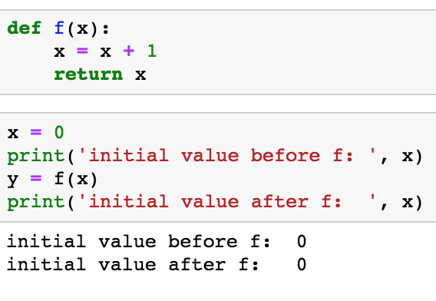
Simple variables not a problem in Python

Slide 5
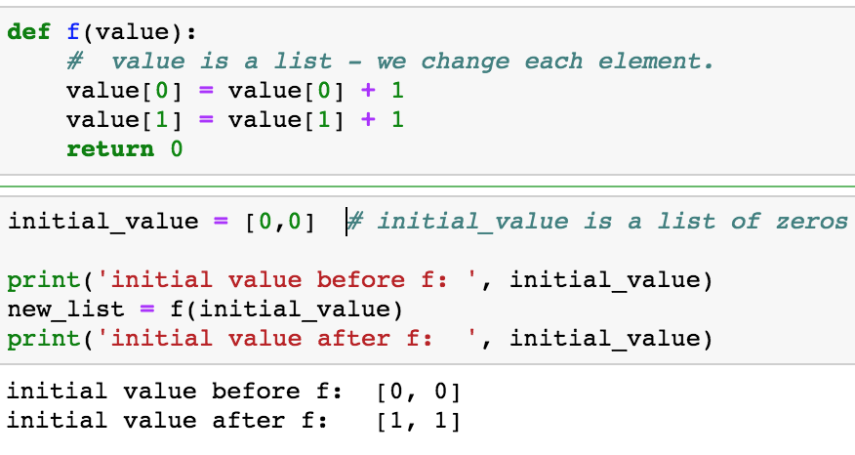
Python Collections are Subject to Side-Effects

Slide 6
Side Effects are a Problem
Parallel computations – if job fails you must reload all data
Distributed computations – problem is job fails or if value of collection changes over time

Slide 7
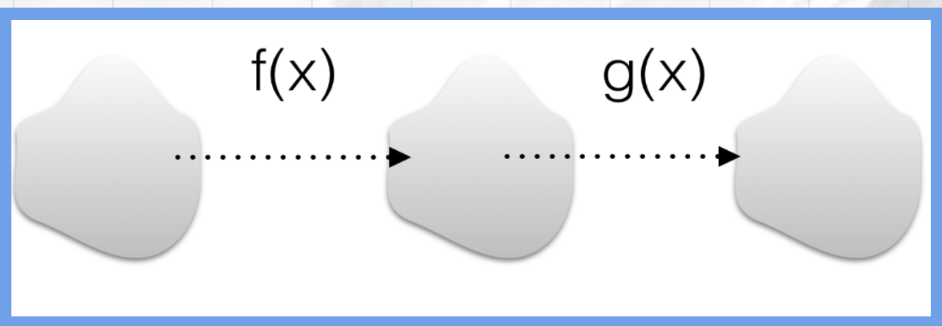
Functional Programming – Immutable Data
Functional Programming does not allow data to change.
You can only create new objects or collections from other objects or collections

Slide 8
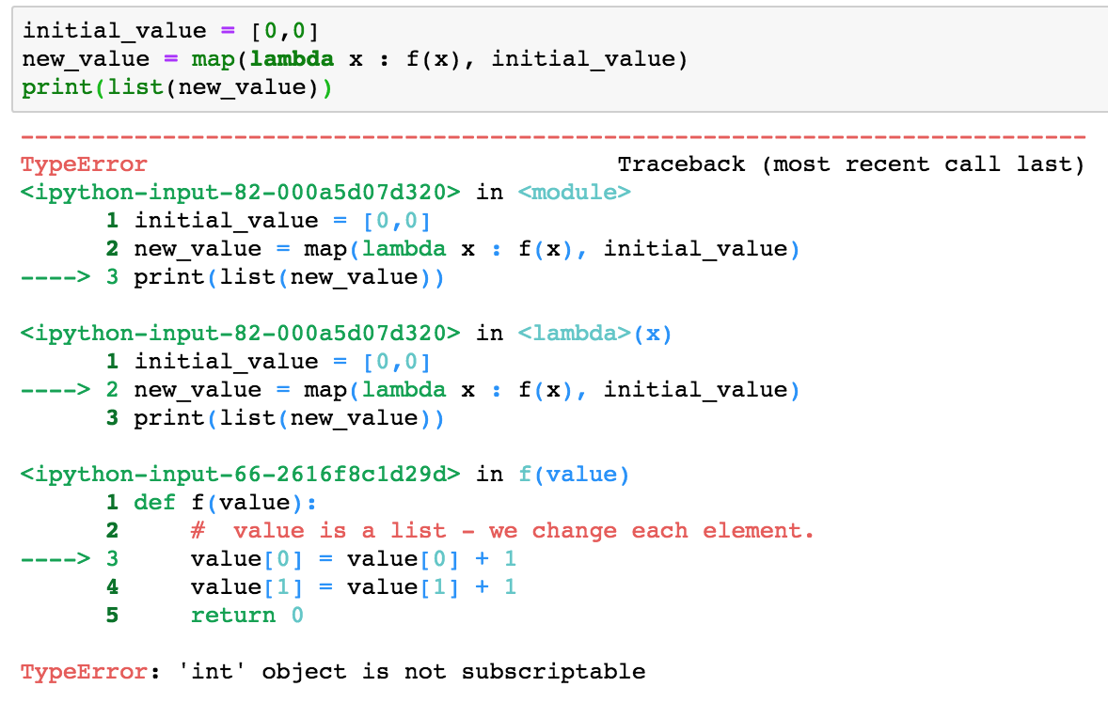
Values are immutable – cannot reach inside the list

Slide 9
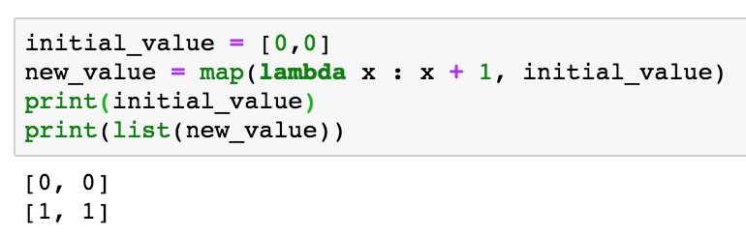
Can only operate on as a whole

Slide 10
Can only operate on the list as a whole

Slide 11
From the Offical Python Documentation
Programming languages support decomposing problems in several different ways:
Most programming languages are procedural: programs are lists of instructions that tell the computer what to do with the program’s input. C, Pascal, and even Unix shells are procedural languages.
In declarative languages, you write a specification that describes the problem to be solved, and the language implementation figures out how to perform the computation efficiently. SQL is the declarative language you’re most likely to be familiar with; a SQL query describes the data set you want to retrieve, and the SQL engine decides whether to scan tables or use indexes, which subclauses should be performed first, etc.
Object-oriented programs manipulate collections of objects. Objects have internal state and support methods that query or modify this internal state in some way. Smalltalk and Java are object-oriented languages. C++ and Python are languages that support object-oriented programming, but don’t force the use of object-oriented features.
Functional programming decomposes a problem into a set of functions. Ideally, functions only take inputs and produce outputs, and don’t have any internal state that affects the output produced for a given input. Well-known functional languages include the ML family (Standard ML, OCaml, and other variants) and Haskell.
Python Documentation

Slide 12
Side Effects
Procedural and object-oriented programs suffer from side-effects.
A problem if computation needs to be restarted mid-stream
A problem for parallel and distributed computations
This happens because at any given time you do not know what the value of your data is. Collections datatypes are especially vulnerable.
This means lists, dictionaries and maps in python.

Slide 13
Simple variables not a problem in Python

Slide 14
Python Collections are Subject to Side-Effects

Slide 15
Side Effects are a Problem
Parallel computations – if job fails you must reload all data
Distributed computations – problem is job fails or if value of collection changes over time

Slide 16
Functional Programming – Immutable Data
Functional Programming does not allow data to change.
You can only create new objects or collections from other objects or collections

Slide 17
Values are immutable – cannot reach inside the list

Slide 18
From the Offical Python Documentation
Programming languages support decomposing problems in several different ways:
Most programming languages are procedural: programs are lists of instructions that tell the computer what to do with the program’s input. C, Pascal, and even Unix shells are procedural languages.
In declarative languages, you write a specification that describes the problem to be solved, and the language implementation figures out how to perform the computation efficiently. SQL is the declarative language you’re most likely to be familiar with; a SQL query describes the data set you want to retrieve, and the SQL engine decides whether to scan tables or use indexes, which subclauses should be performed first, etc.
Object-oriented programs manipulate collections of objects. Objects have internal state and support methods that query or modify this internal state in some way. Smalltalk and Java are object-oriented languages. C++ and Python are languages that support object-oriented programming, but don’t force the use of object-oriented features.
Functional programming decomposes a problem into a set of functions. Ideally, functions only take inputs and produce outputs, and don’t have any internal state that affects the output produced for a given input. Well-known functional languages include the ML family (Standard ML, OCaml, and other variants) and Haskell.
Python Documentation

Slide 19
Side Effects
Procedural and object-oriented programs suffer from side-effects.
A problem if computation needs to be restarted mid-stream
A problem for parallel and distributed computations
This happens because at any given time you do not know what the value of your data is. Collections datatypes are especially vulnerable.
This means lists, dictionaries and maps in python.

Slide 20
Simple variables not a problem in Python

Slide 21
Python Collections are Subject to Side-Effects

Slide 22
Side Effects are a Problem
Parallel computations – if job fails you must reload all data
Distributed computations – problem is job fails or if value of collection changes over time

Slide 23
Functional Programming – Immutable Data
Functional Programming does not allow data to change.
You can only create new objects or collections from other objects or collections

Slide 24
Values are immutable – cannot reach inside the list

Slide 26
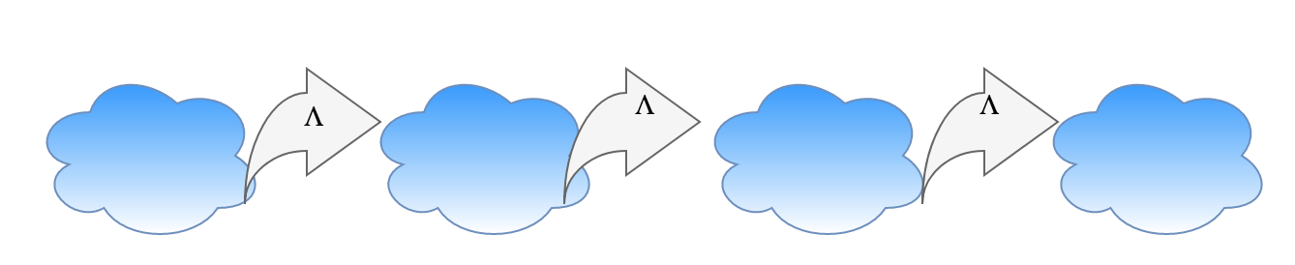
Lambda Expressions
Map a domain to a range
Values in these domains are immutable
Always create a new object

Slide 27
Advantages
Formal provability.
Modularity.
Composability.
Ease of debugging and testing.

